Slide 1
Geography

Slide 2
Deep time, shifting continents

Slide 3
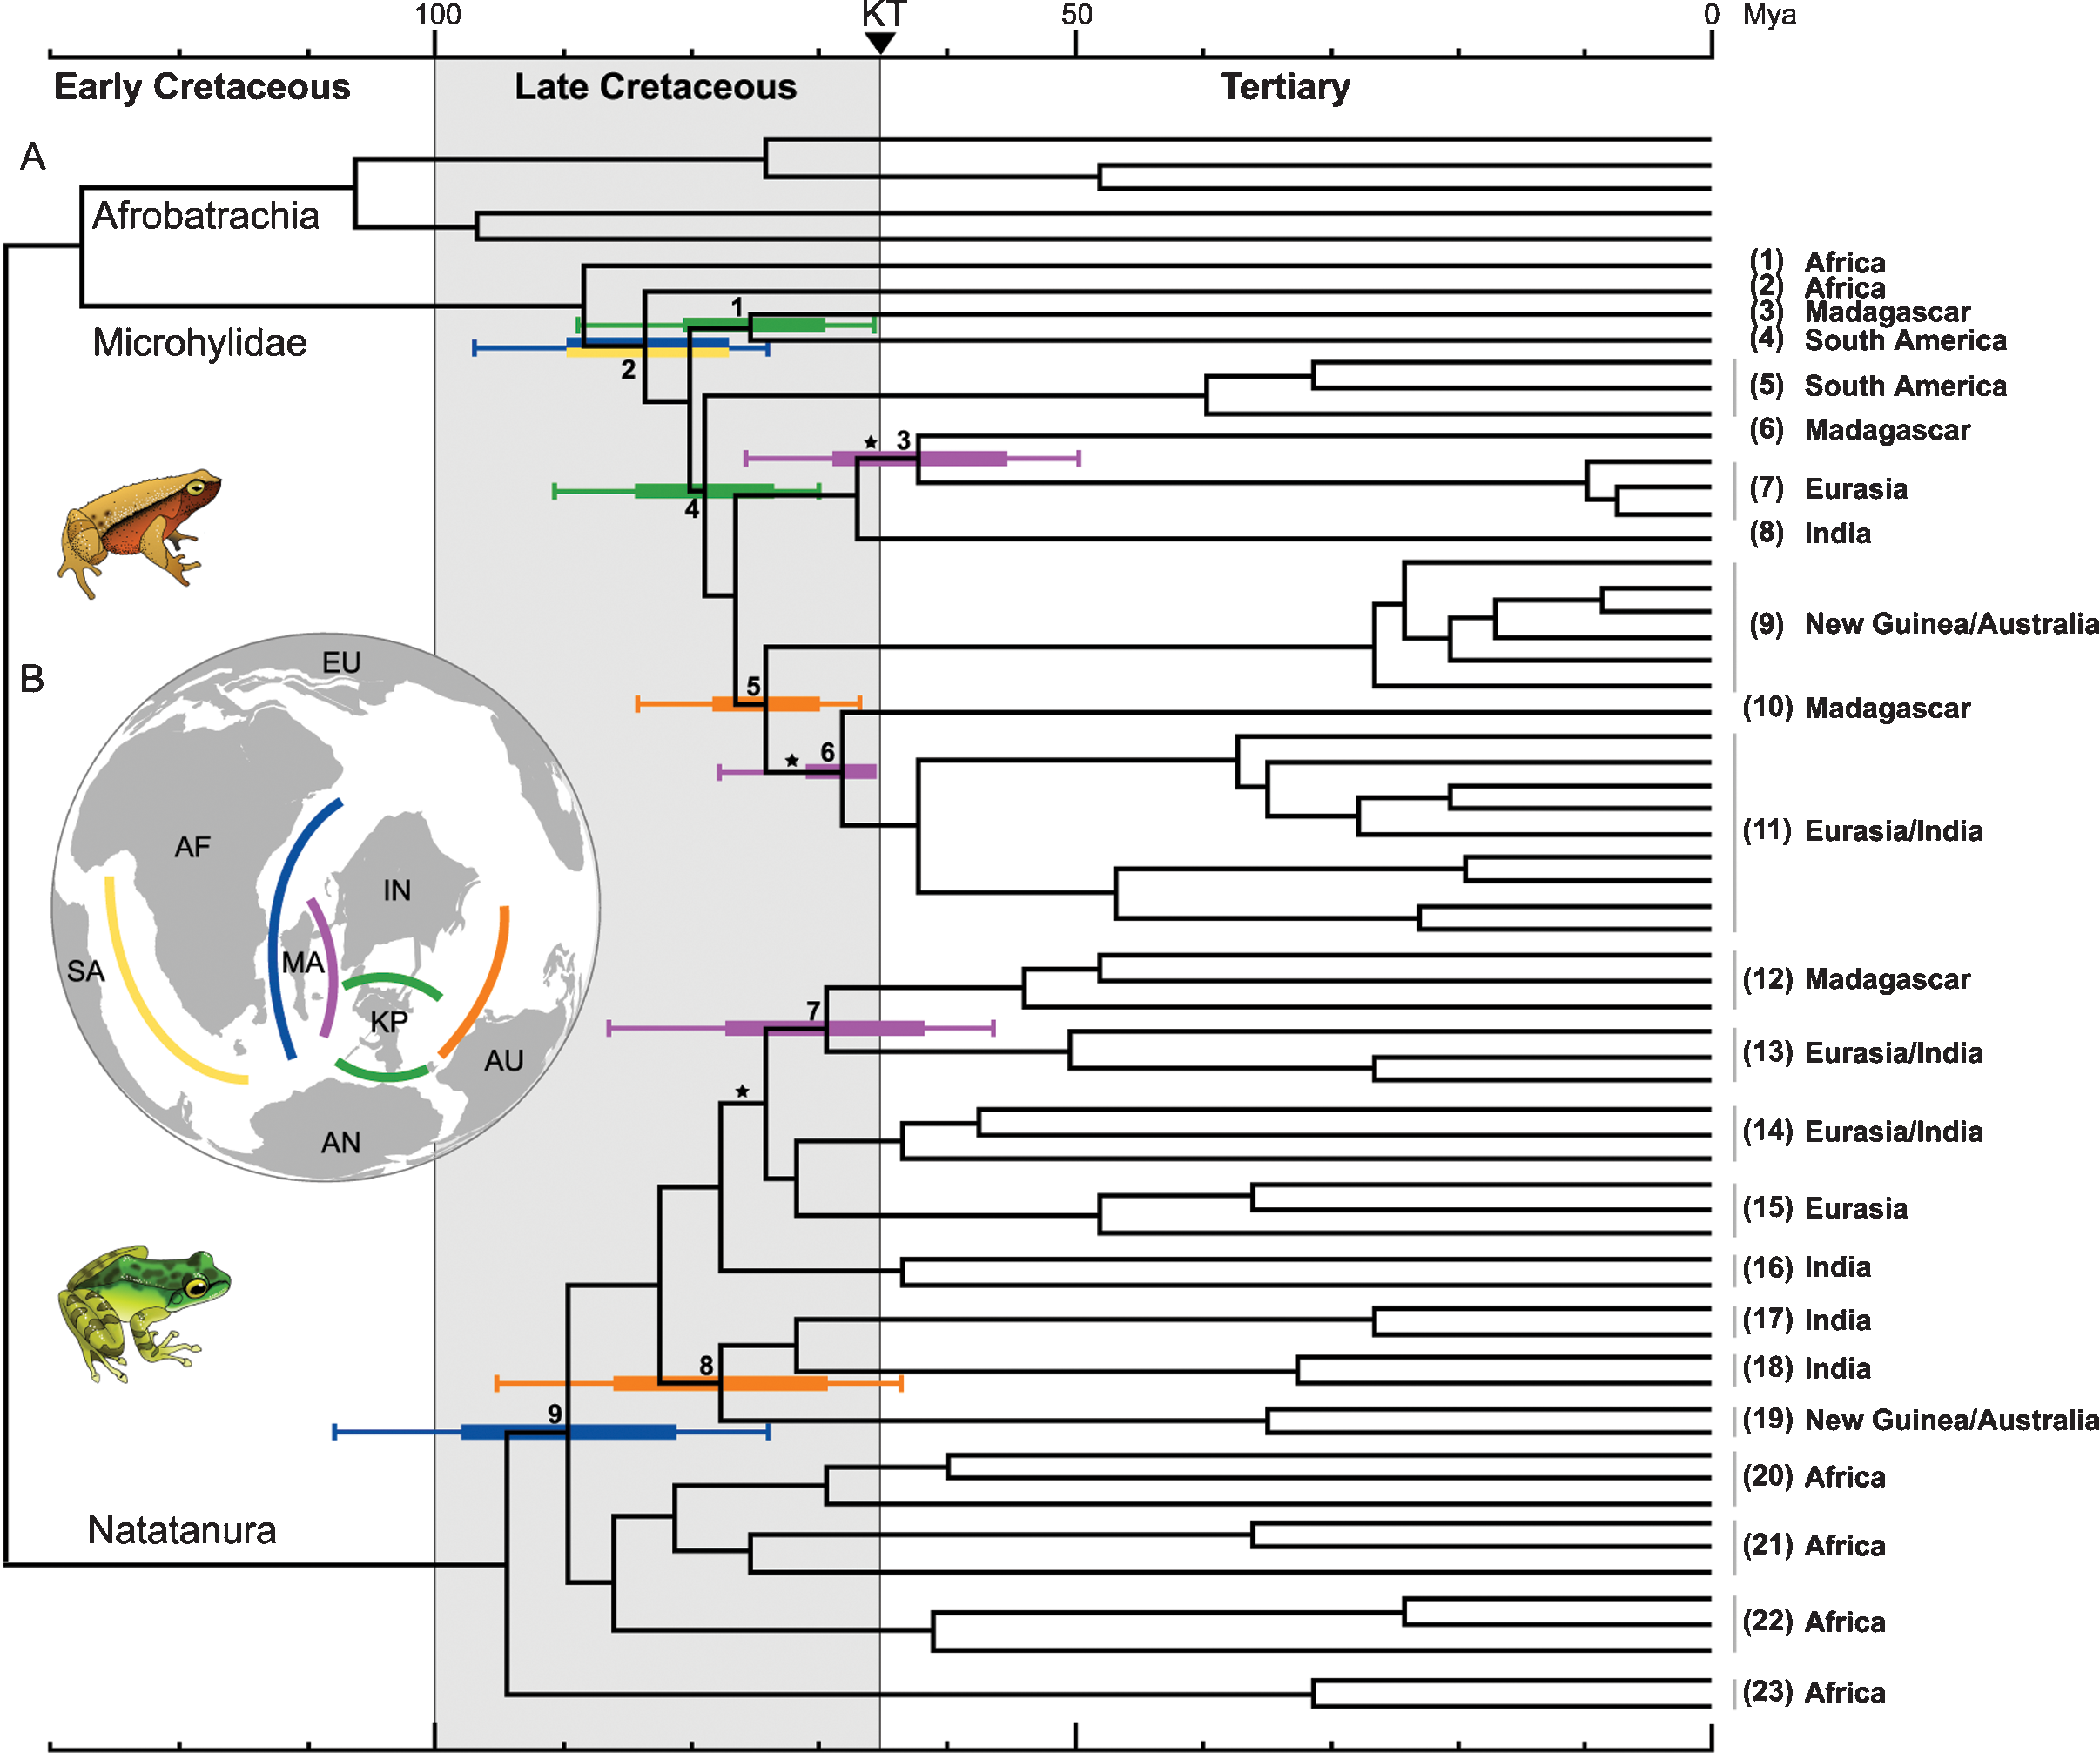
Millions of years

Slide 4
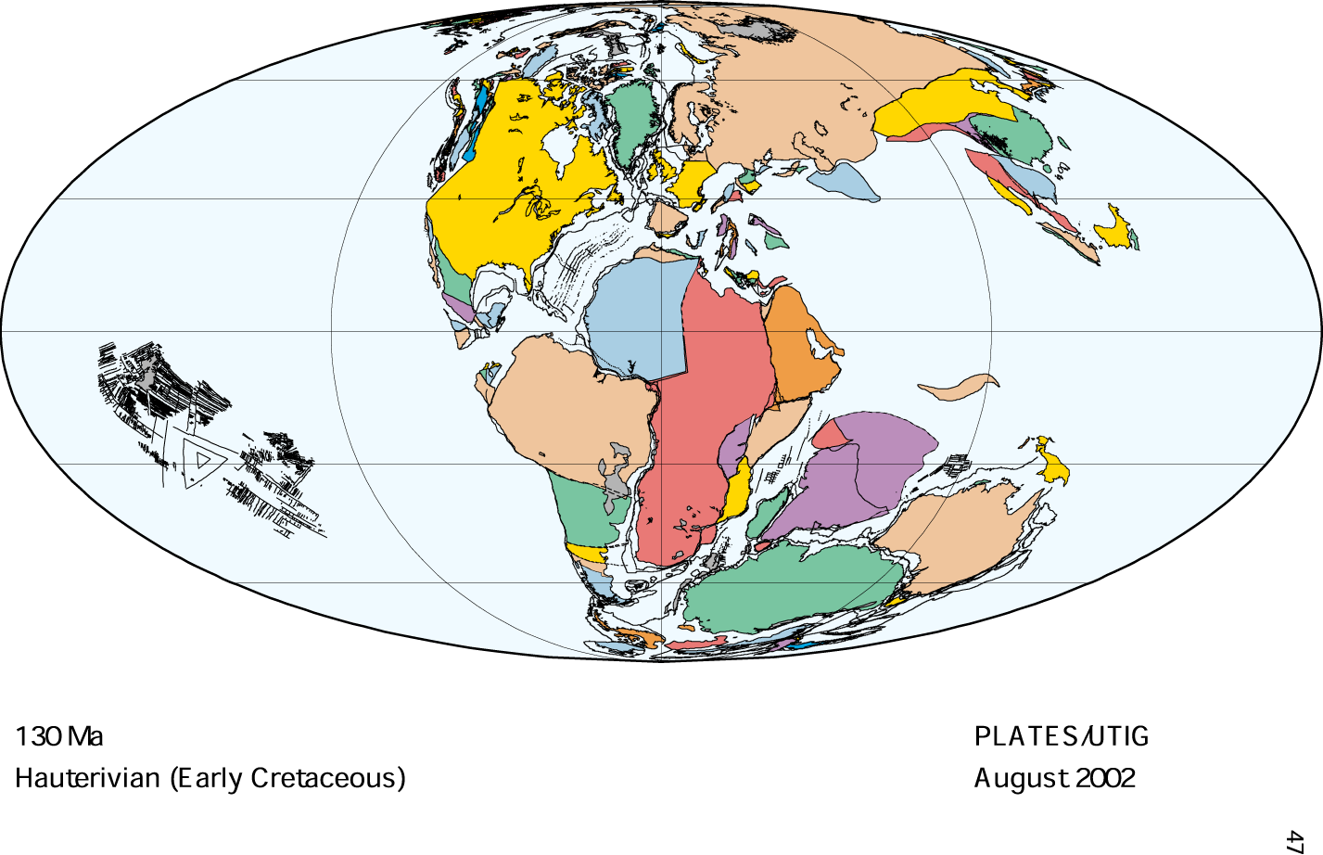

Slide 5
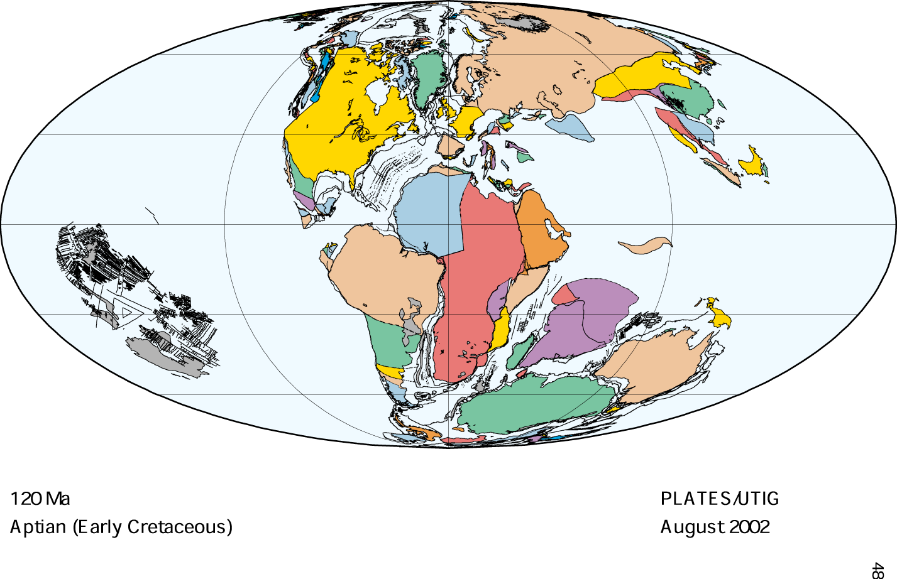

Slide 6
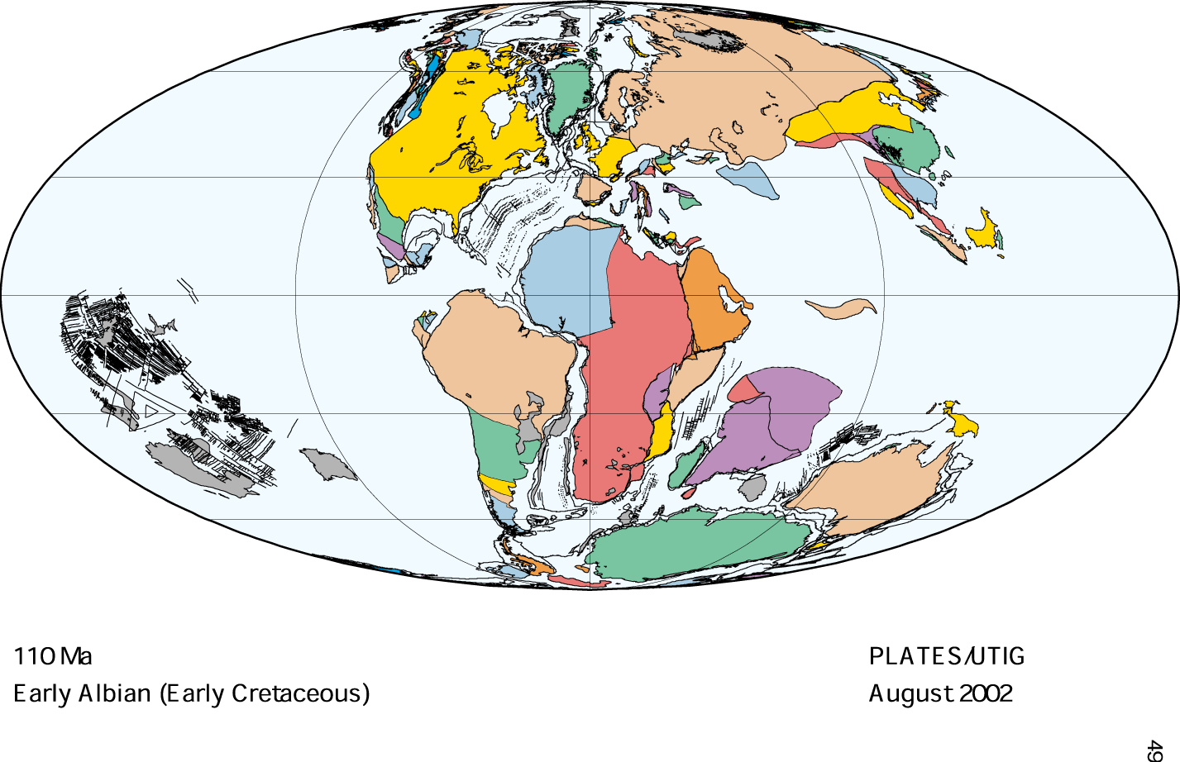

Slide 7
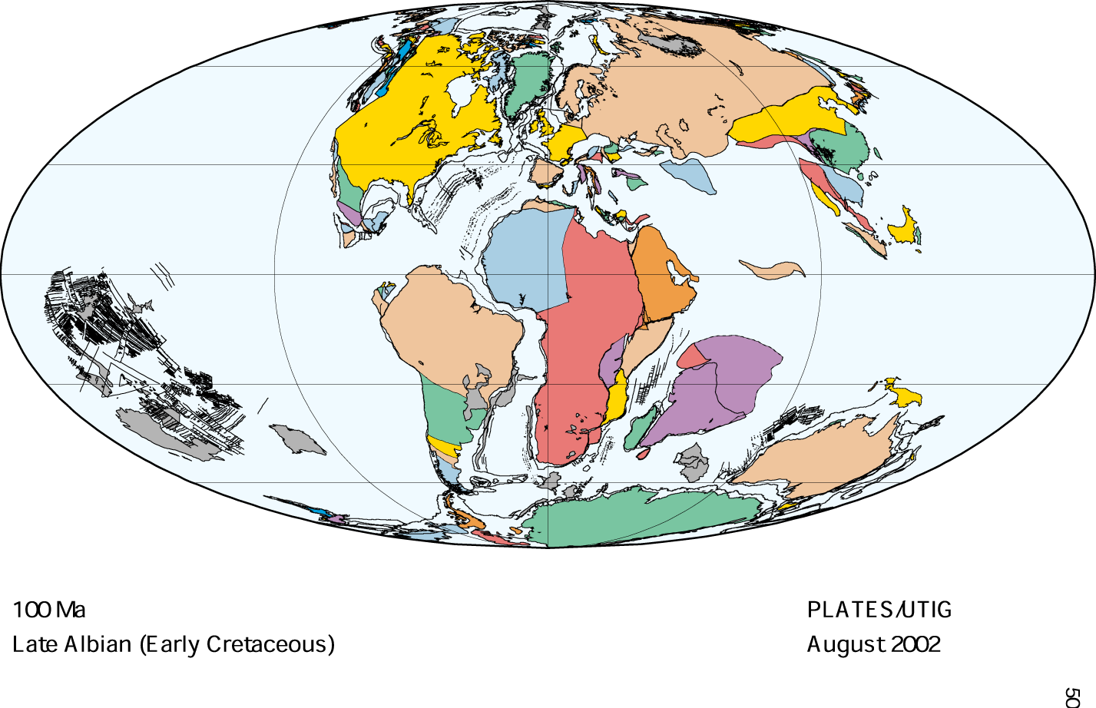

Slide 8
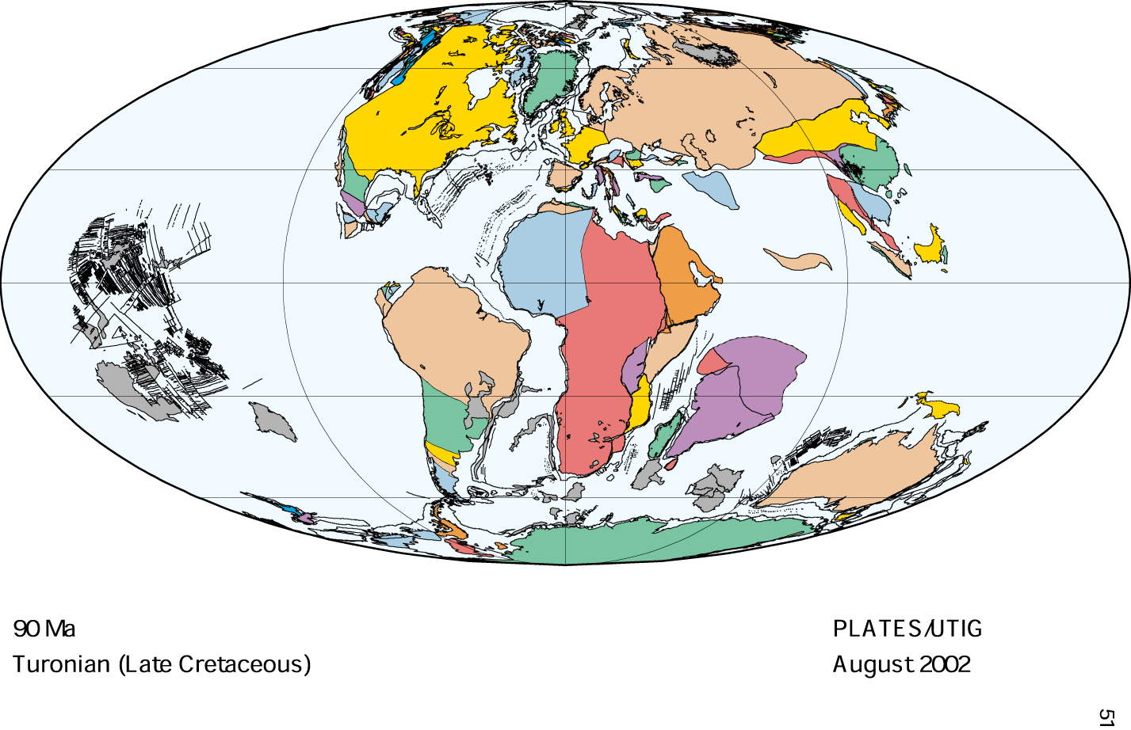

Slide 9
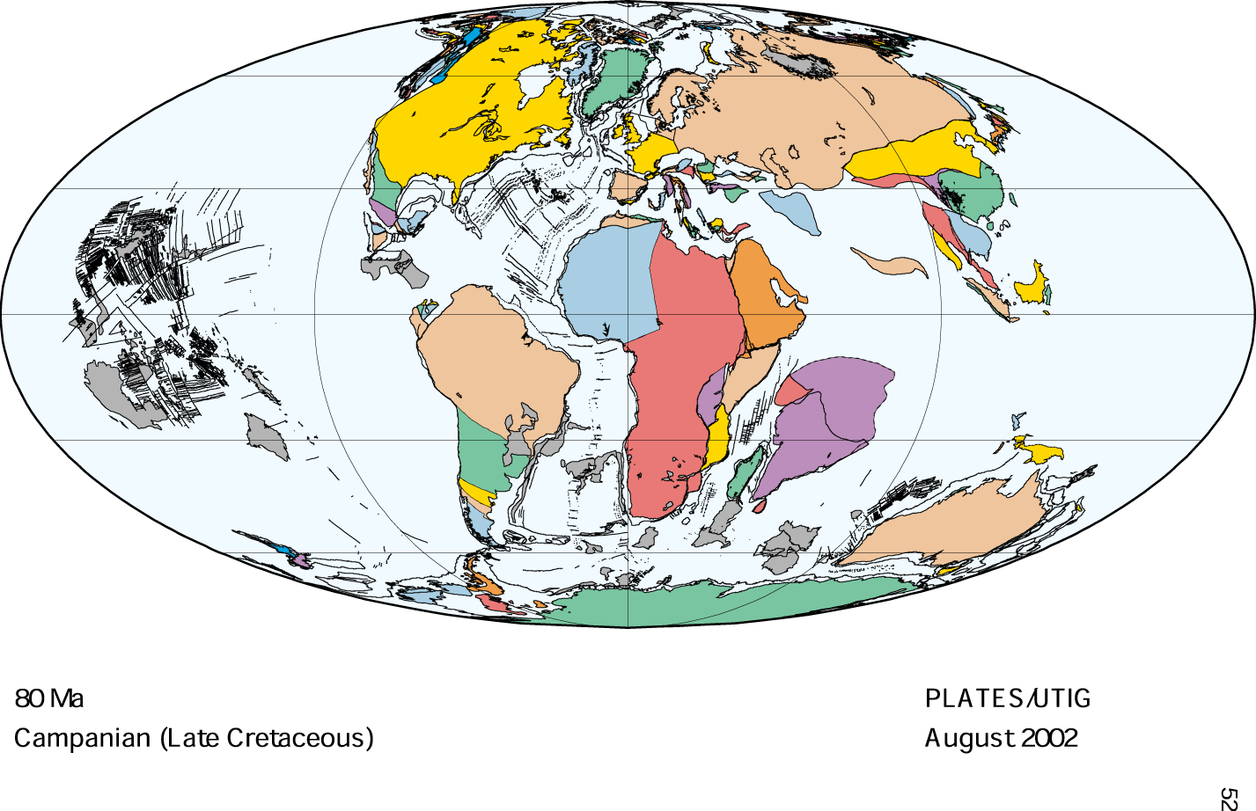

Slide 10
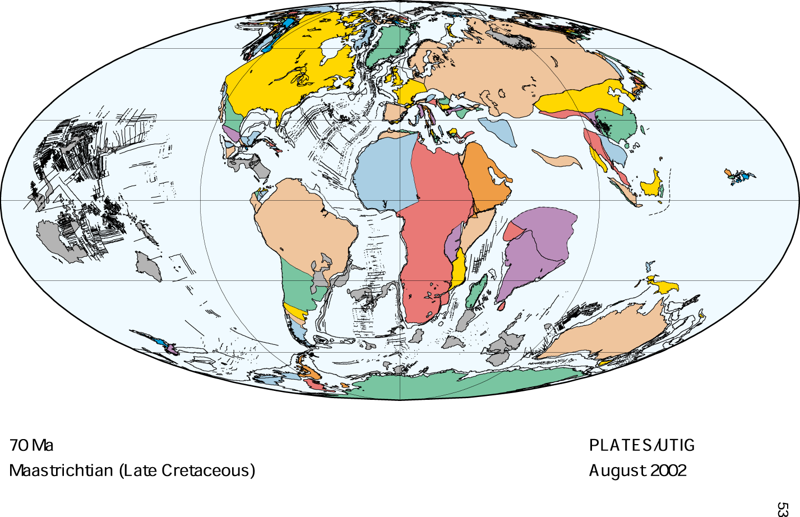

Slide 11
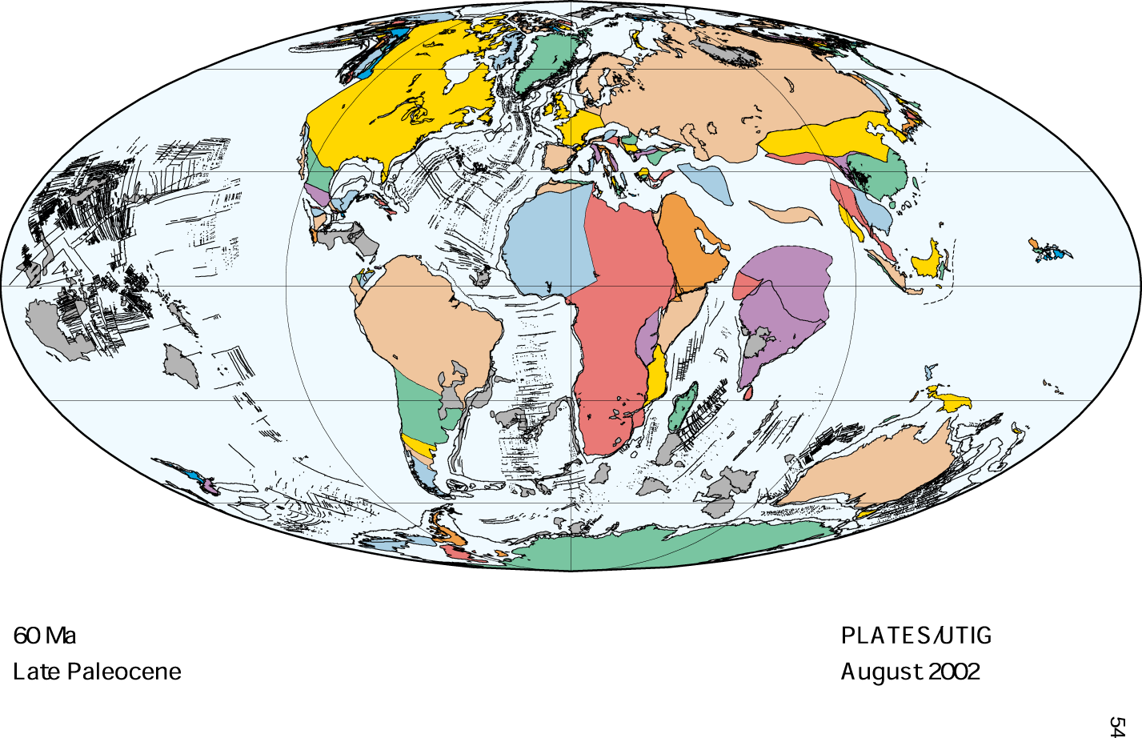

Slide 12
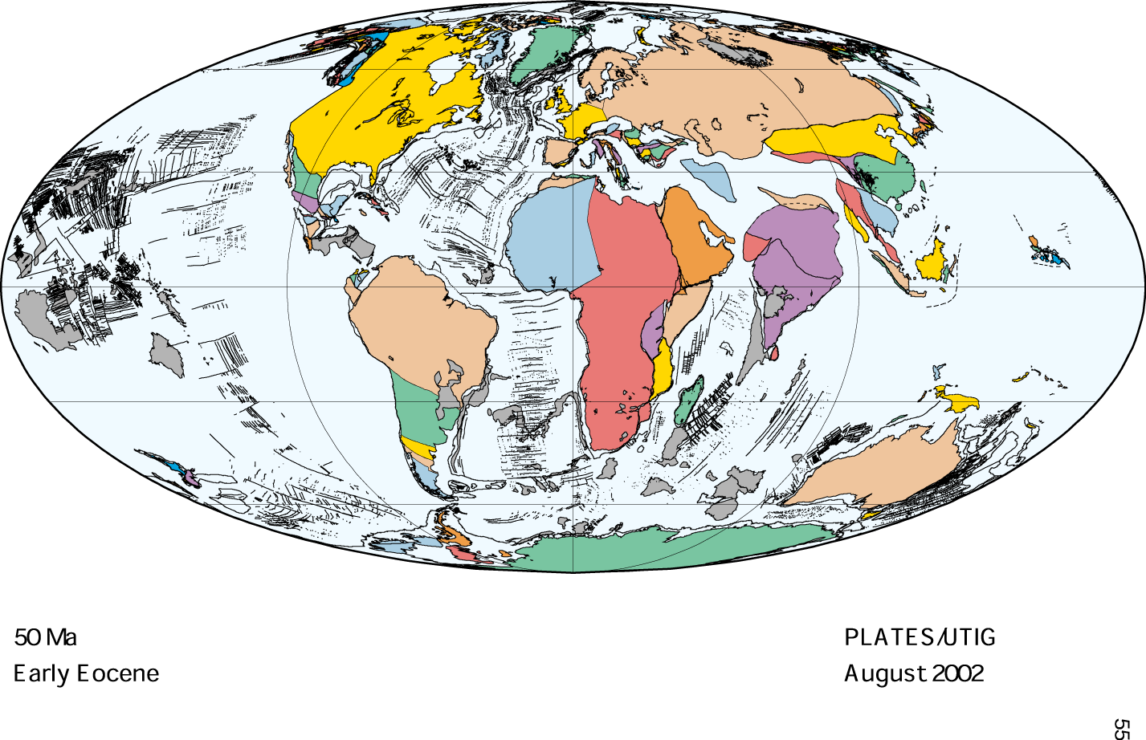

Slide 13
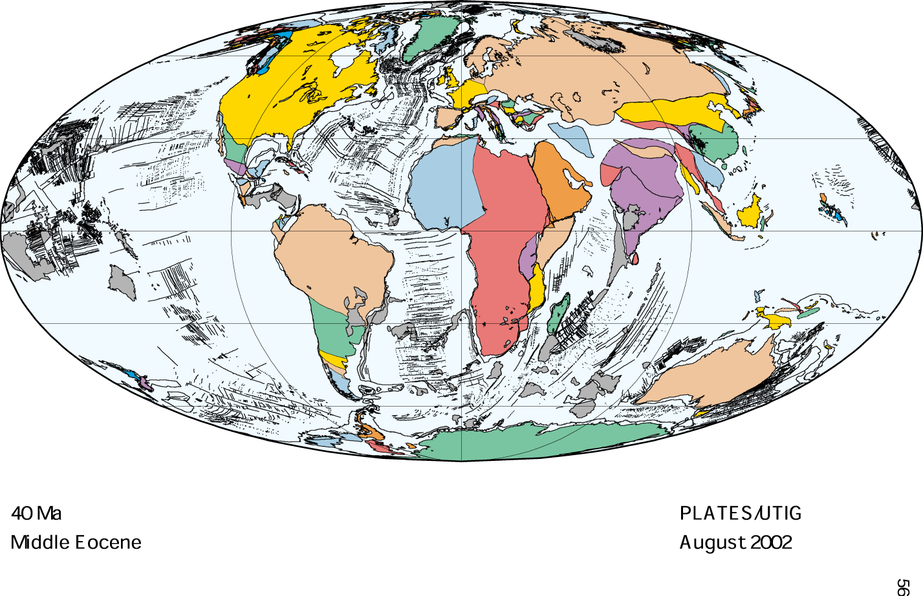

Slide 14
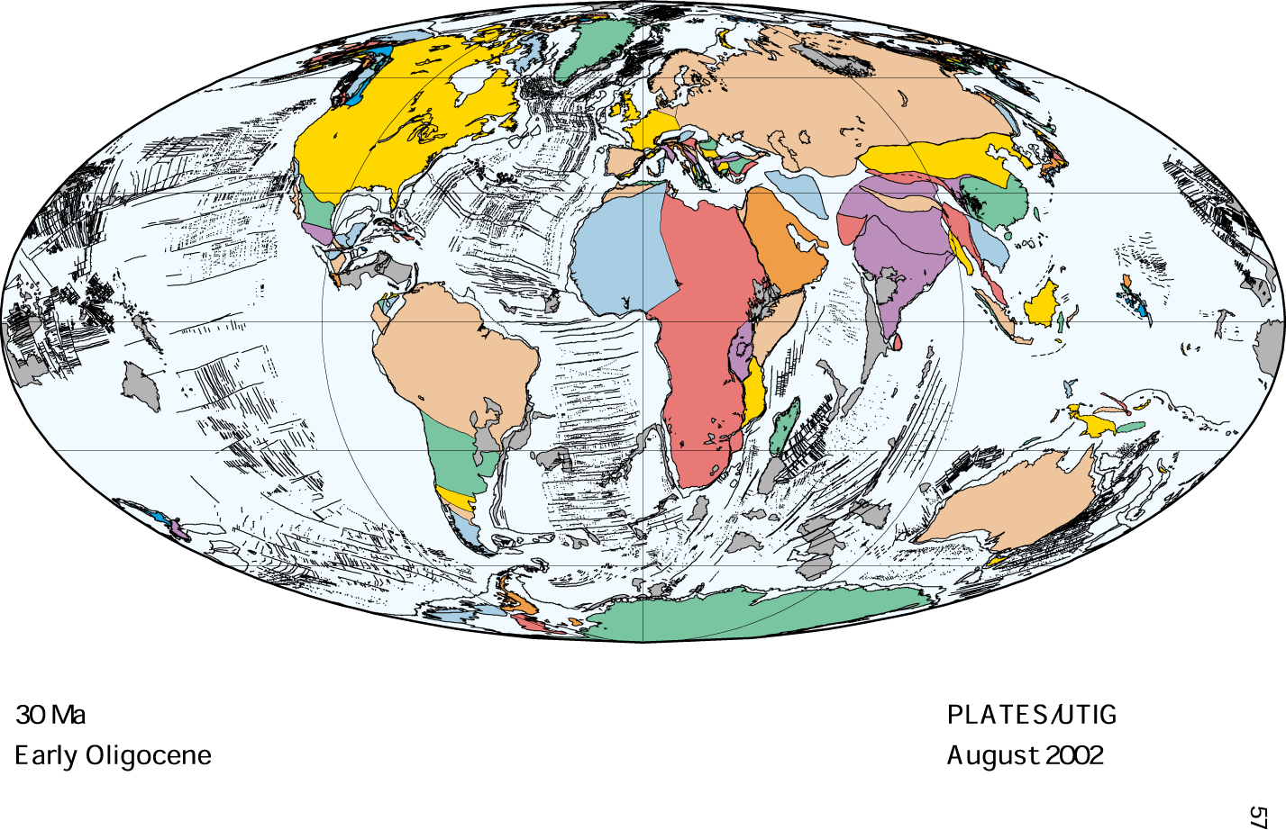

Slide 15
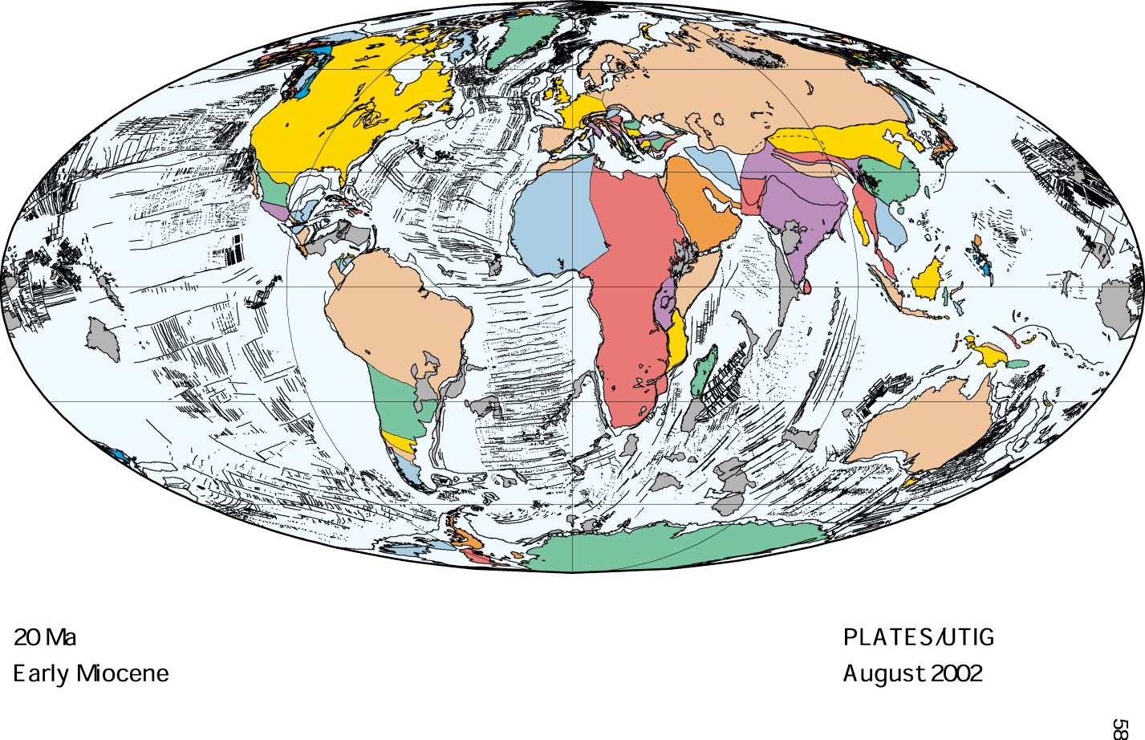

Slide 16
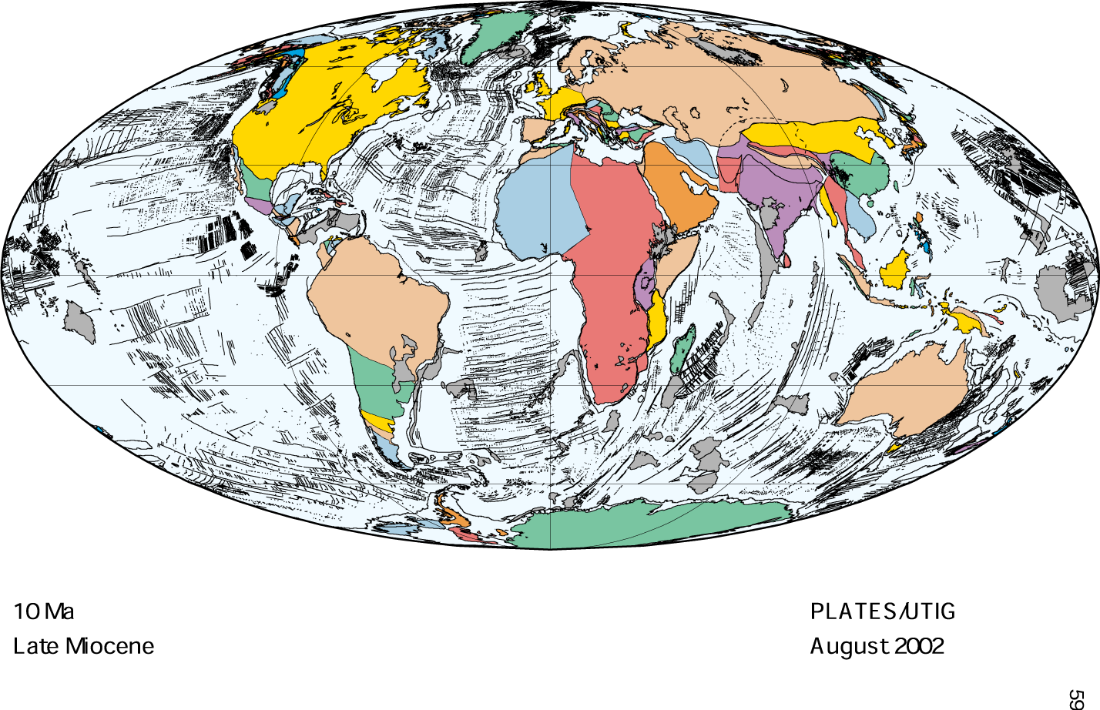

Slide 17
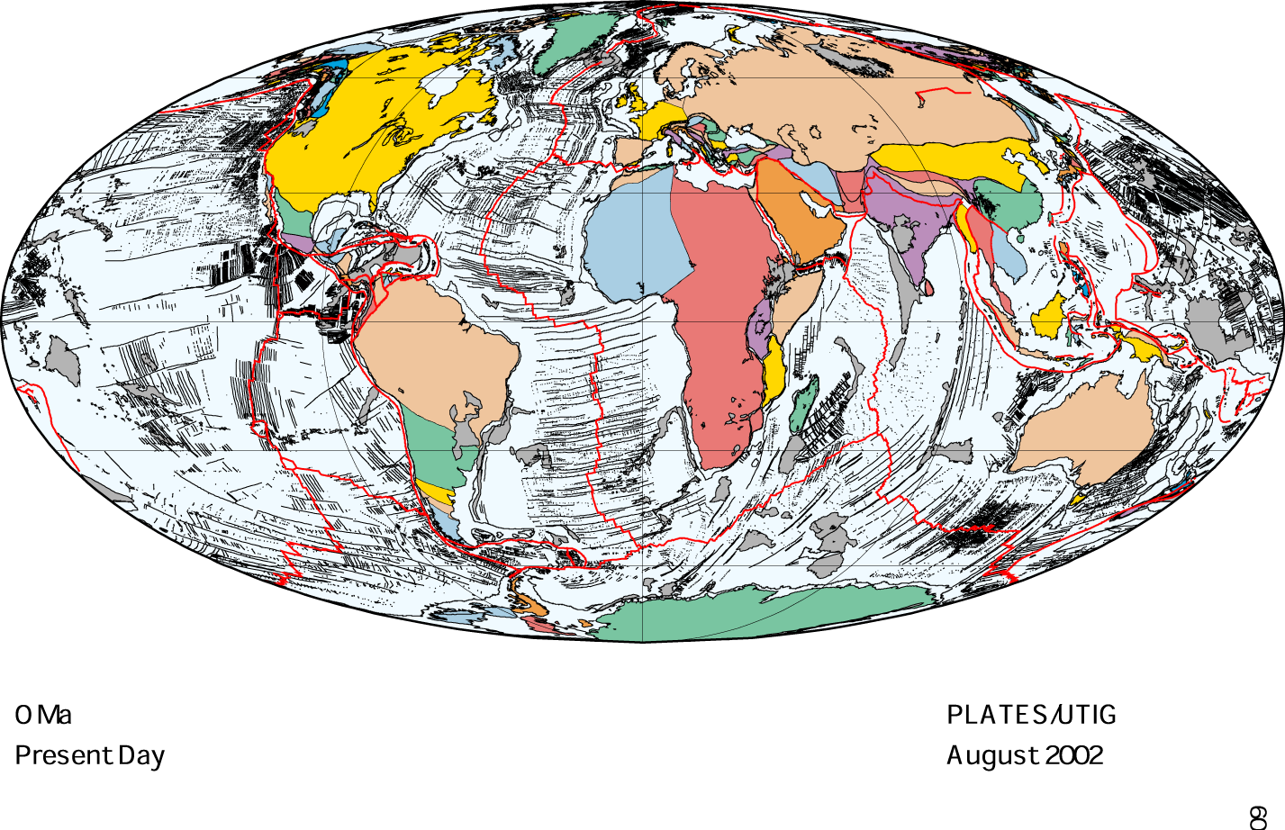

Slide 18
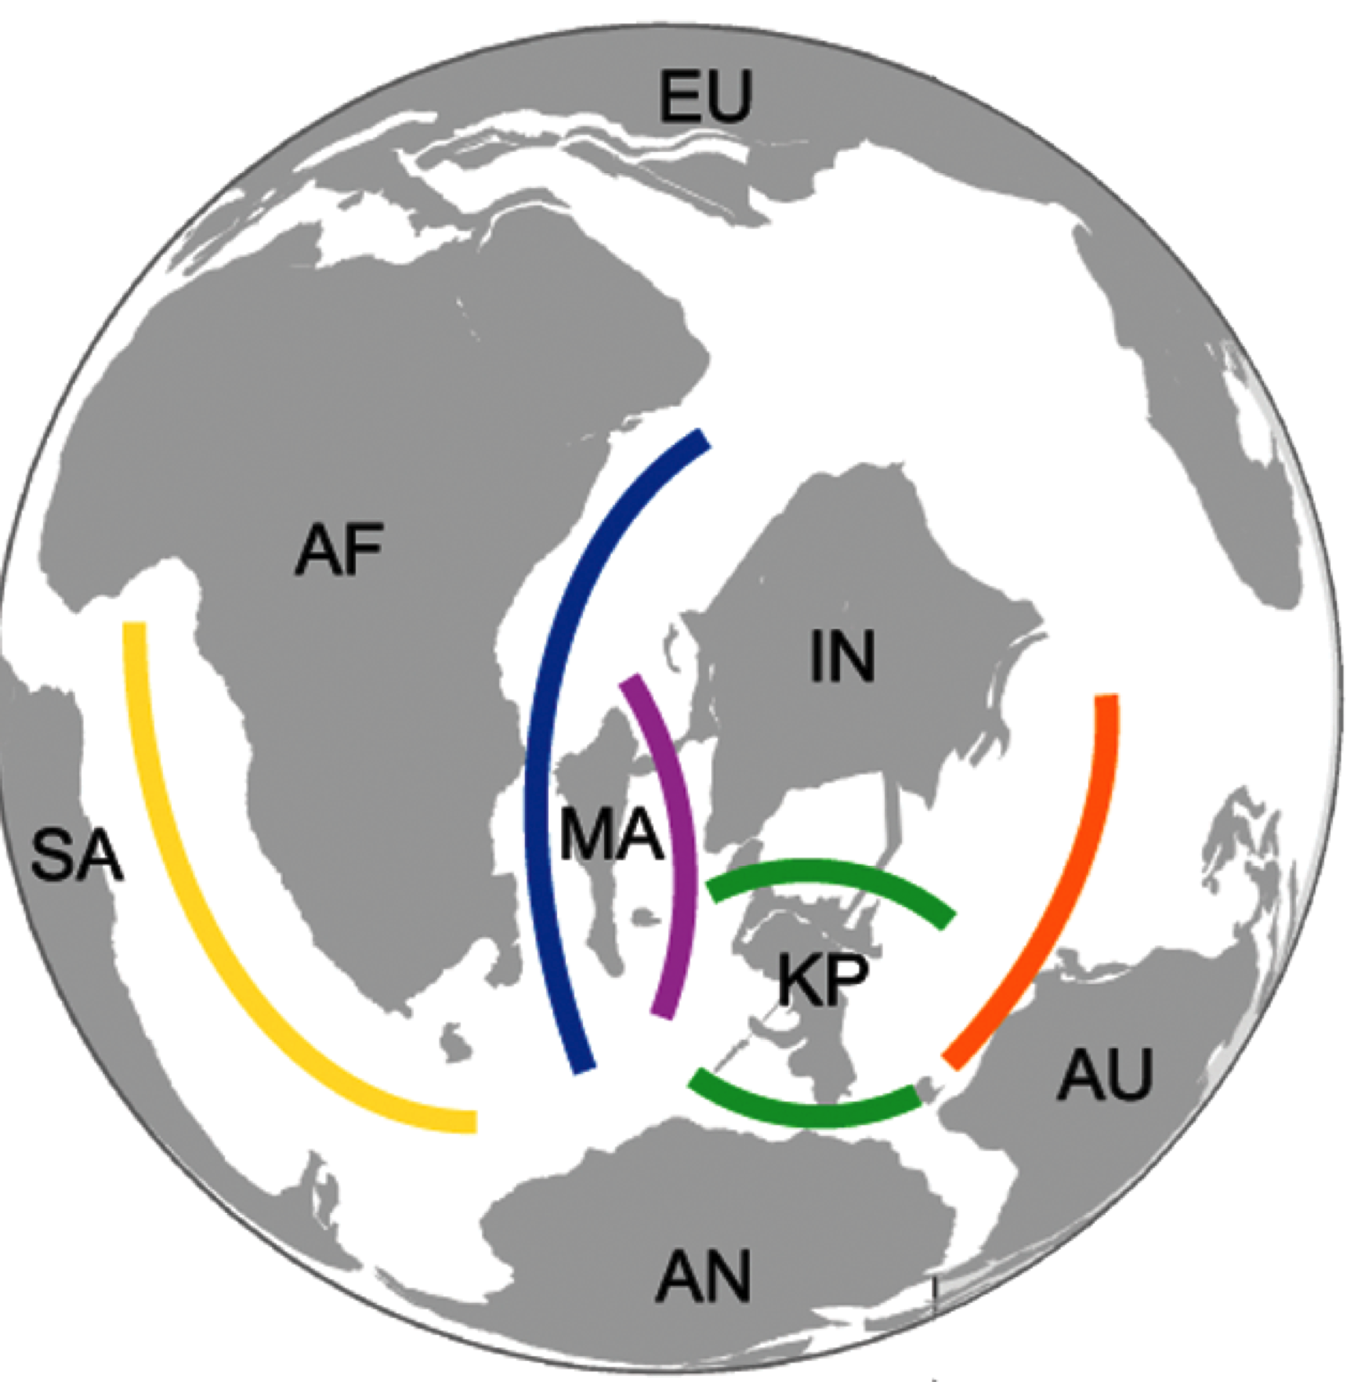
Millions of years ago
130
90
110
100
110

Slide 19
Geological area cladogram
Africa
130
South America
110
90
Madagascar
India
100
Australia
New Guinea

Slide 20
Africa
130
South America
90
Madagascar
110
India
100
Australia
New Guinea

Slide 21
Recent time, shifting organisms

Slide 22

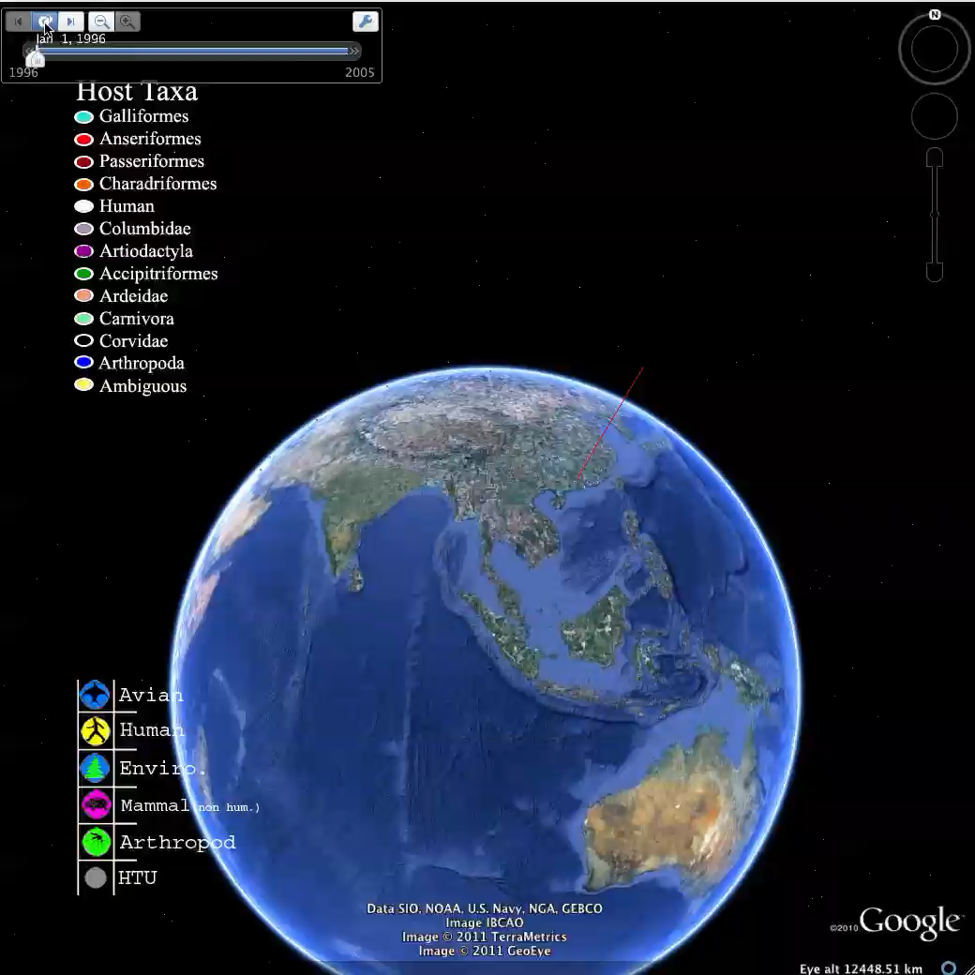
@andrewxhill

Slide 23
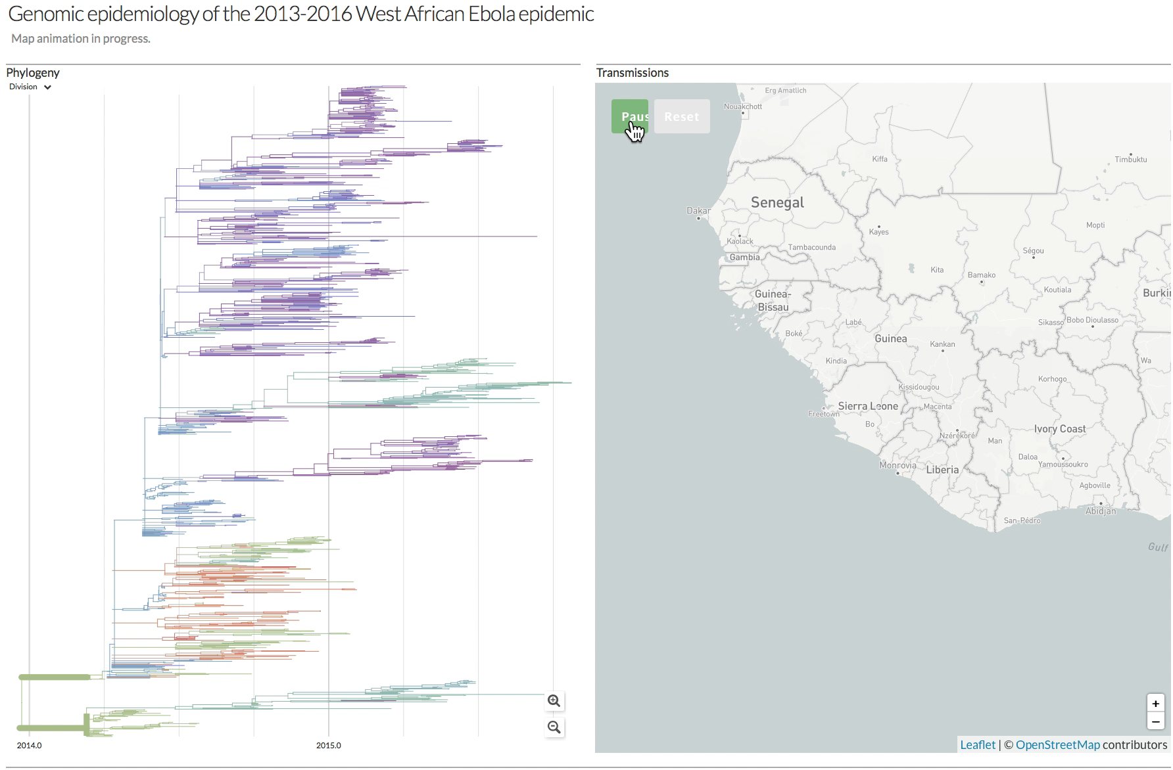
Ebola virus
http://www.nextstrain.org/ebola

Slide 24
Sinking island, running to stay in the same place

Slide 25
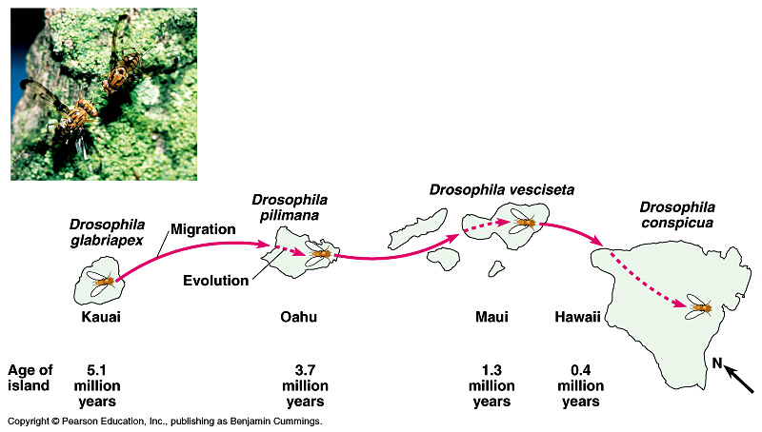
Figure 22.16 The evolution of fruit fly (Drosophila) species on the Hawaiian archipelago

Slide 26
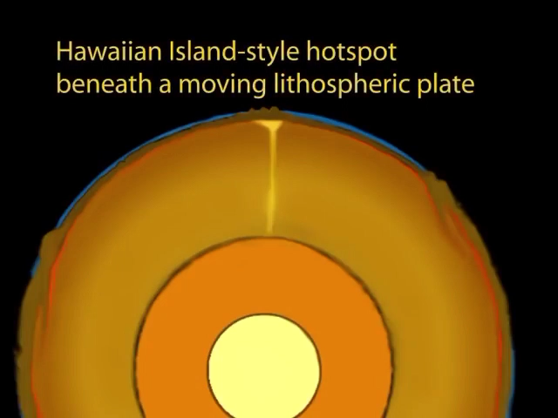
Hotspot

Slide 27
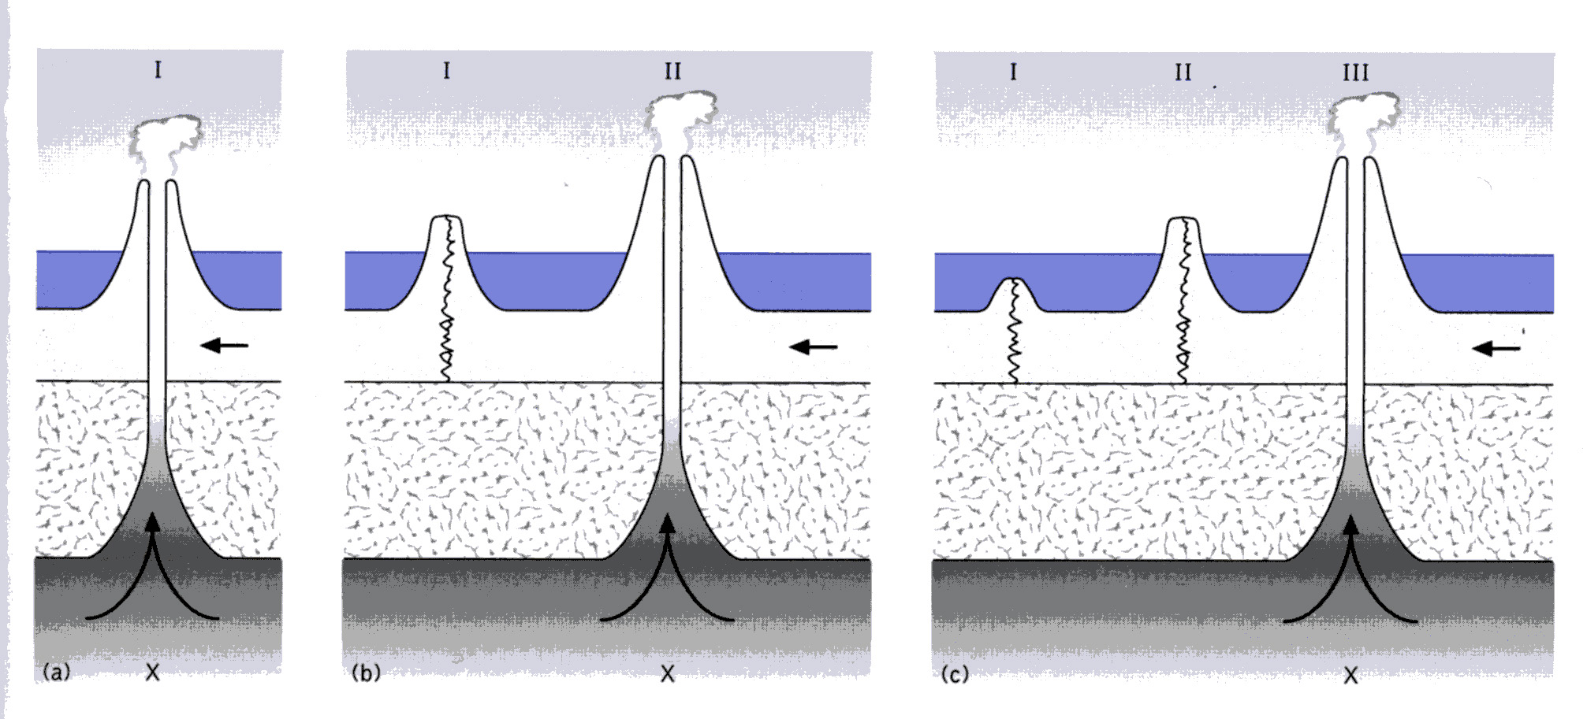
Hotspot

Slide 28
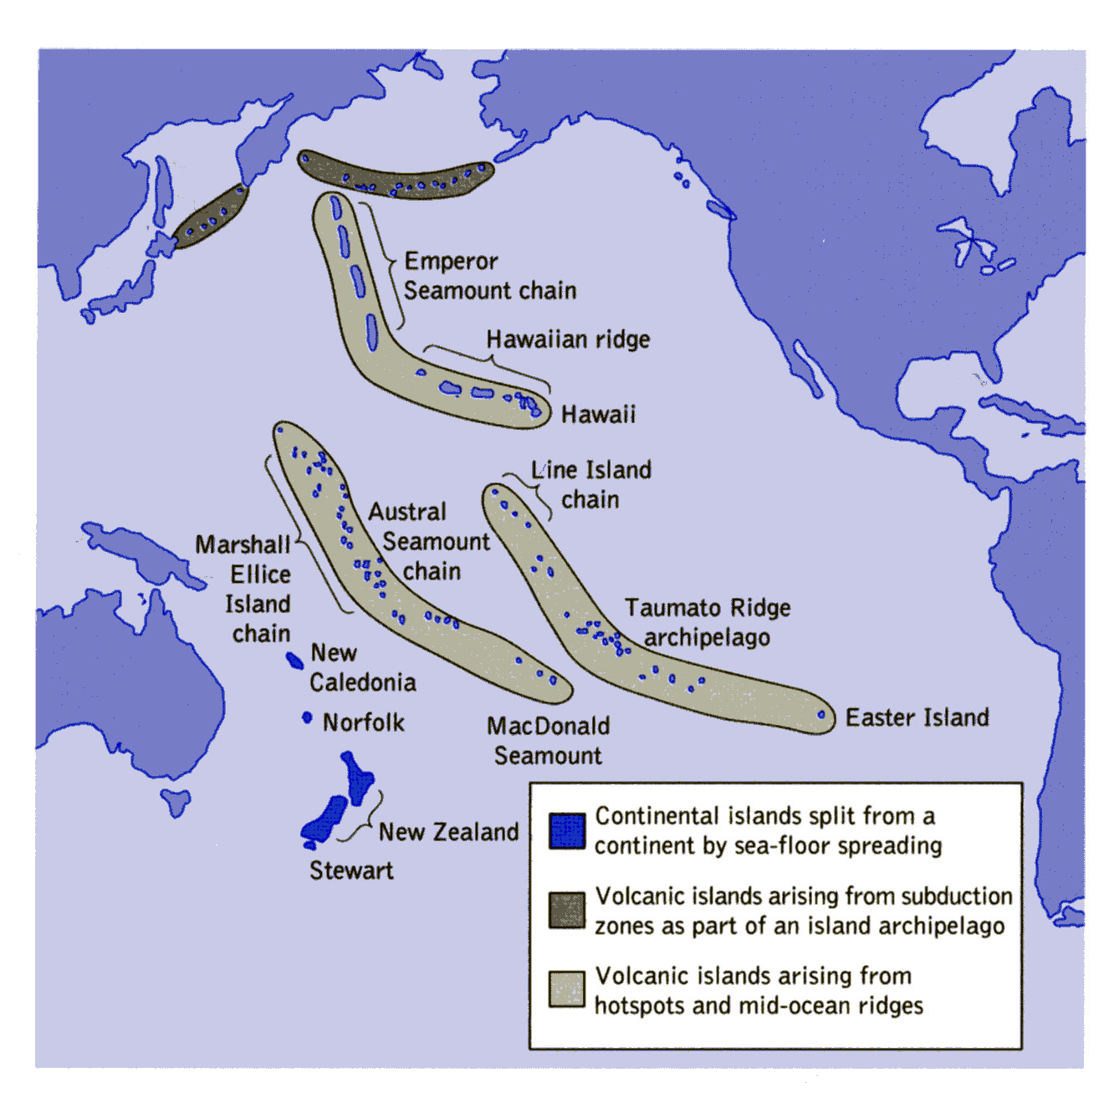

Slide 29
Life and maps
Static life and moving continents
Static land and shifting organisms
Moving land and moving organisms

Slide 30
Properties of maps

Slide 31
Maps are predictable

Slide 32
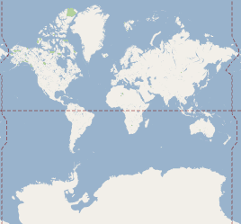

Slide 34
Navigation is predictable

Slide 35
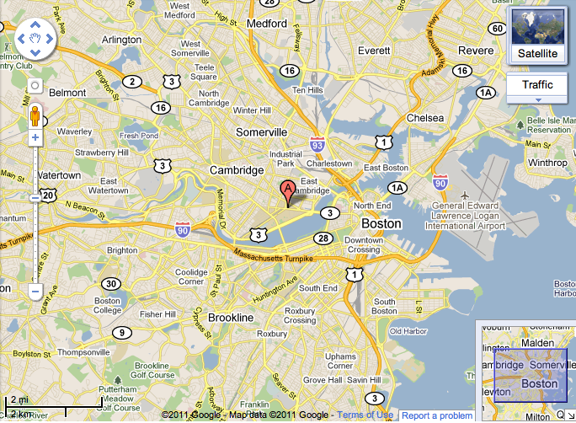

Slide 36
Every pixel counts

Slide 38
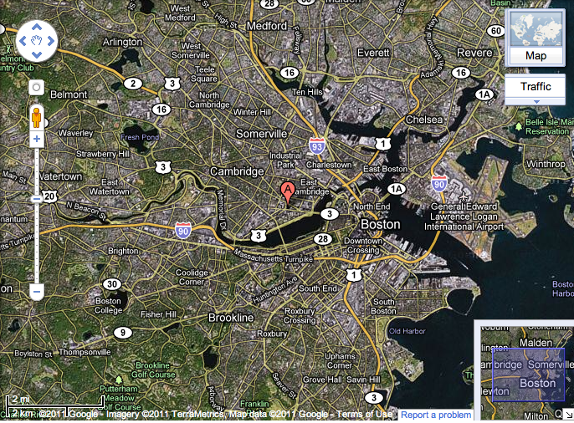

Slide 39
Ground truth

Slide 41
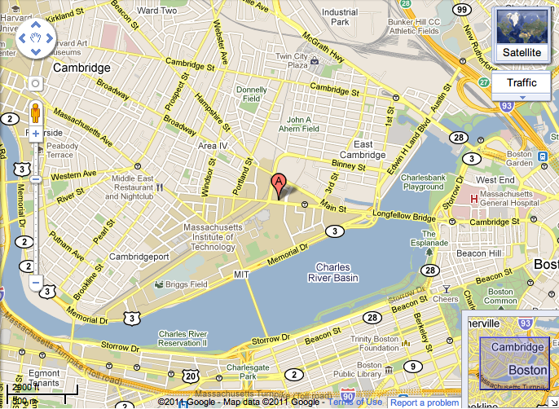

Slide 42
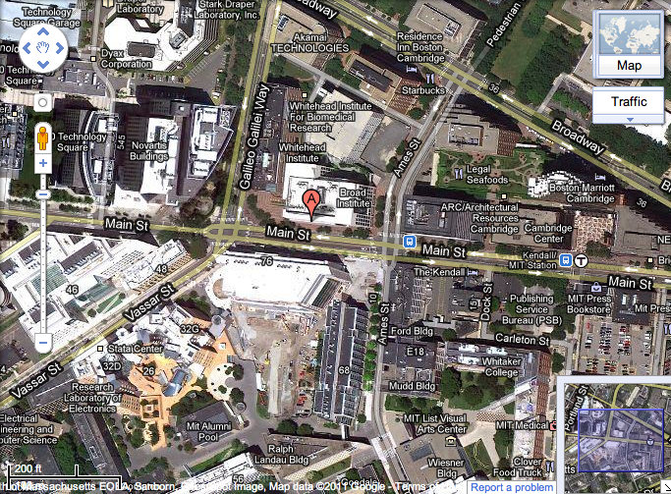

Slide 43
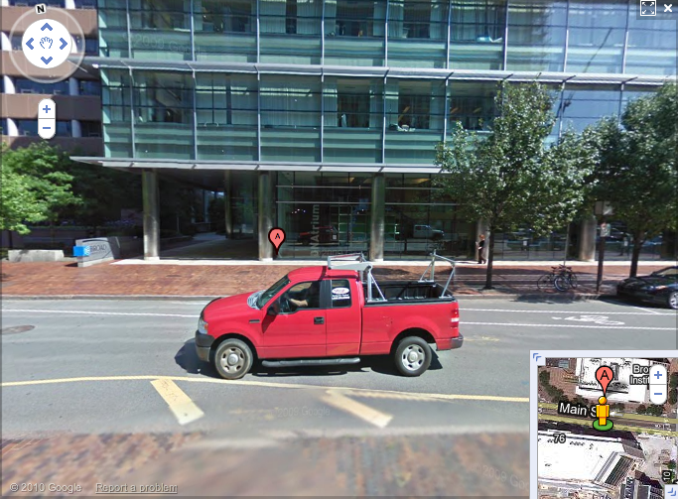

Slide 44
Relative and absolute navigation

Slide 45
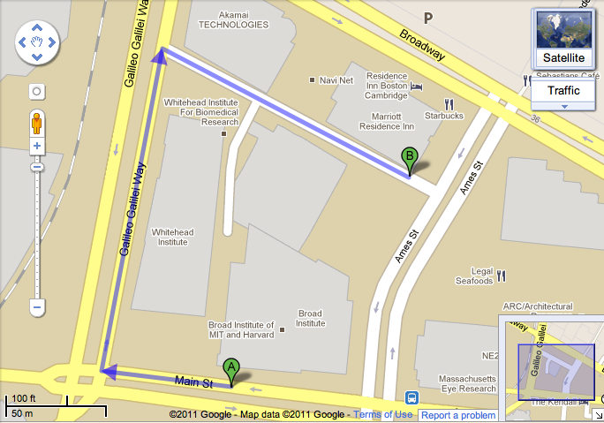

Slide 46

Latitude 42.363921 Longitude -71.087763

Slide 47
Sources of maps (other than Google)

Slide 48
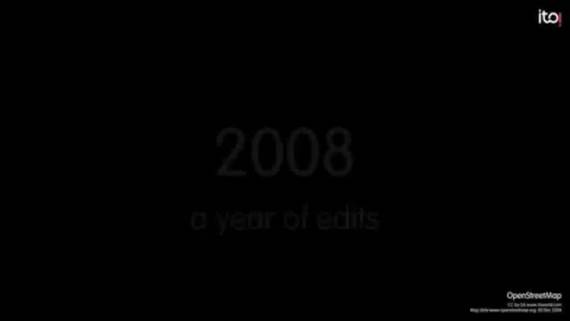
OpenStreetMap

Slide 49
Maps and biodiversity

Slide 50

http://www.gbif.org
See https://www.gbif.org/resource/search?contentType=literature for uses

Slide 51
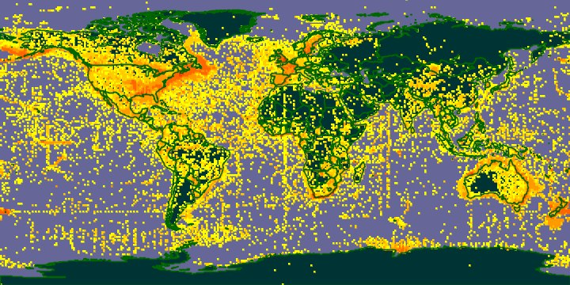

Slide 52
Lots of data, but some issues, such as sampling bias and errors

Slide 53
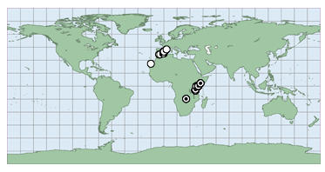
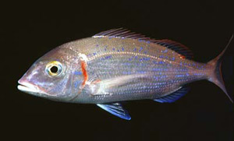
Transposed latitude and longitude

Slide 54
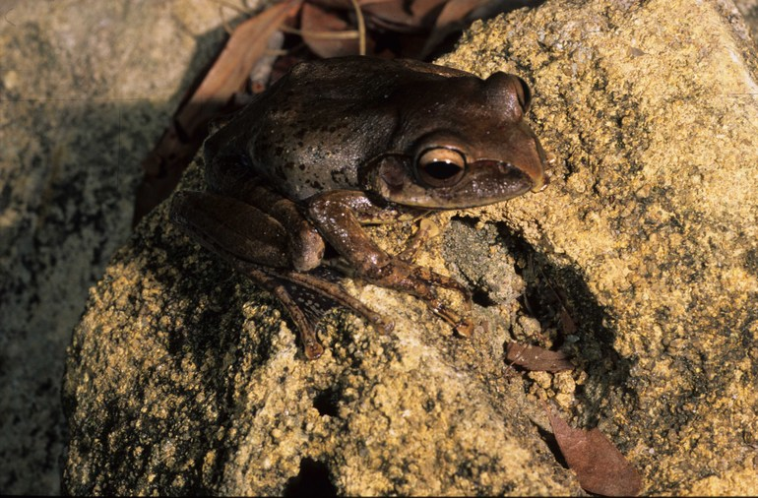
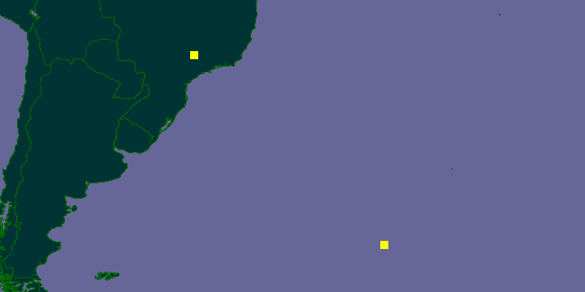
Boophis periegetes

Slide 55
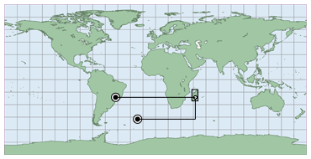
Boophis periegetes

Slide 56
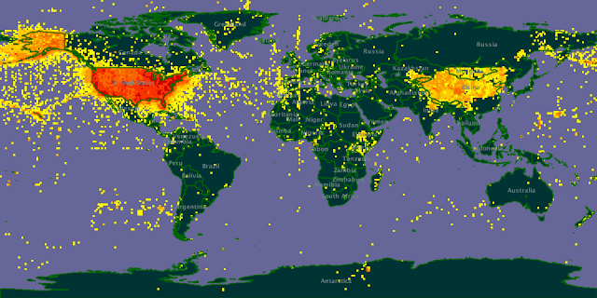
Specimens from “USA”

Slide 57
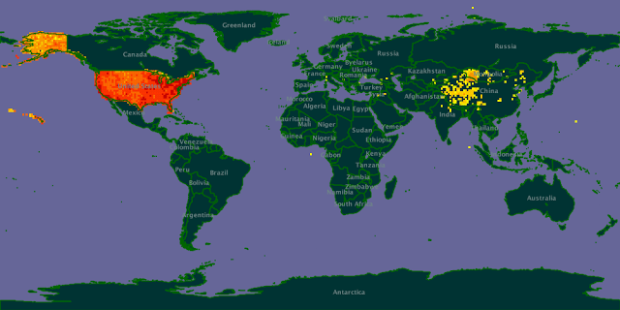

Slide 58
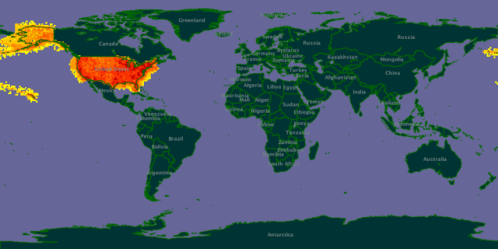

Slide 59
Sampling bias and lack of data

Slide 60

@andrewxhill

Slide 61


Slide 62
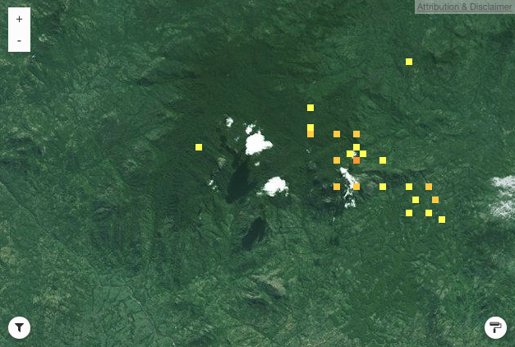
Mt Mabu on GBIF

Slide 63
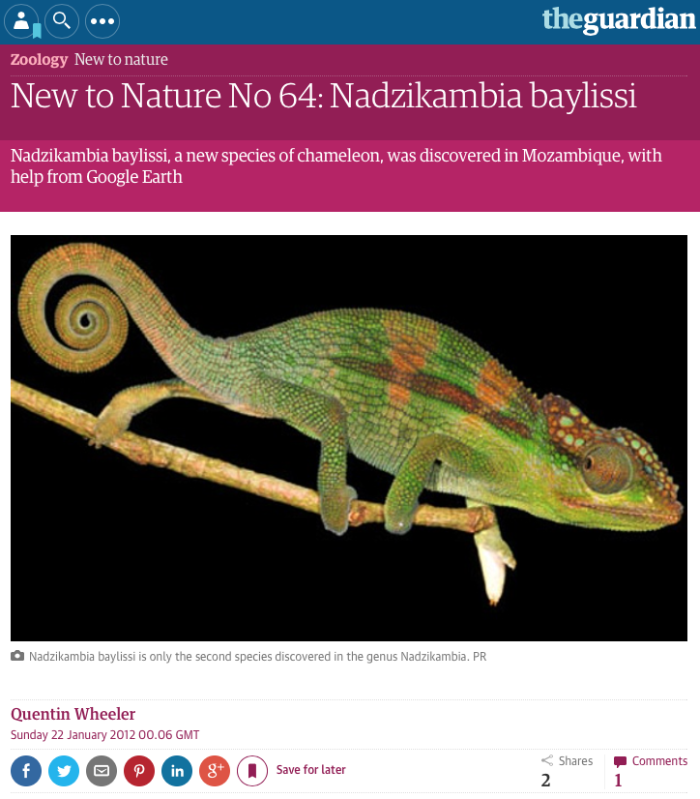

Slide 64
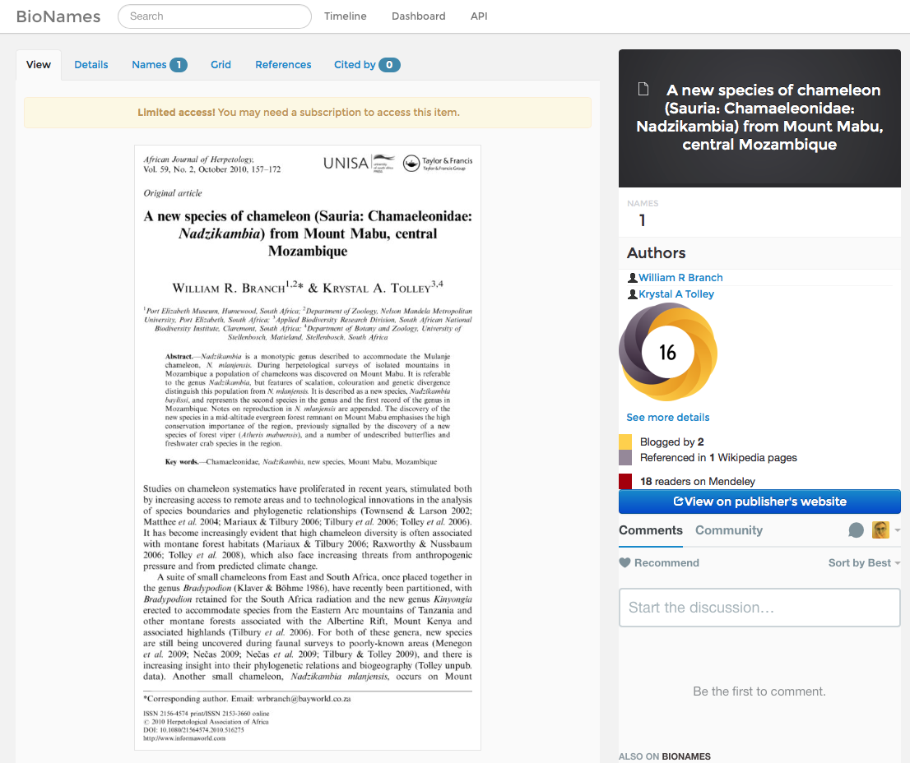
https://bionames.org
Notes:
http://bionames.org/references/702d63814e74063632a9d99b5ba72d15

Slide 65
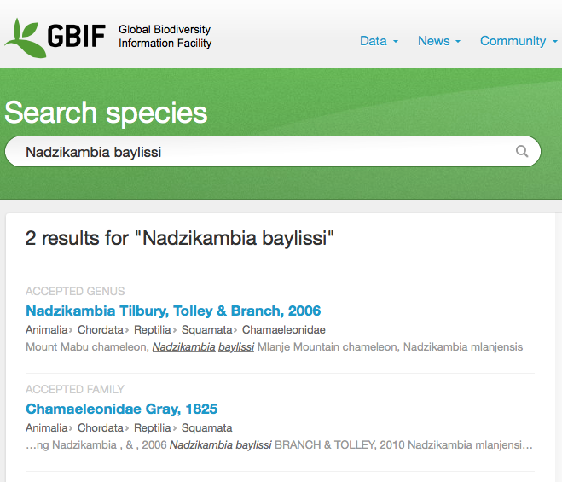

Slide 66
How can we correct sampling bias?

Slide 67
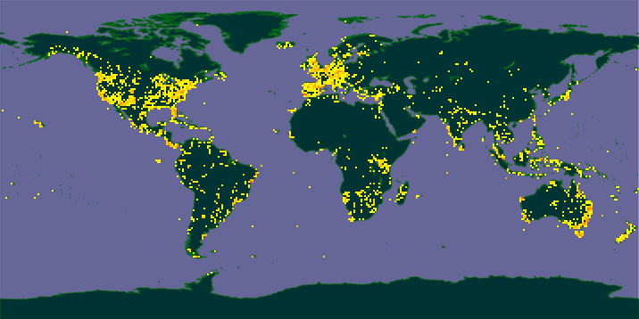
Flickr EOL group

Slide 68
Crowd sourcing
Where is the “crowd”?
It’s where the iPhones are…

Slide 69
Making more sophisticated maps
Timelines, layers, drawing on maps

Slide 70
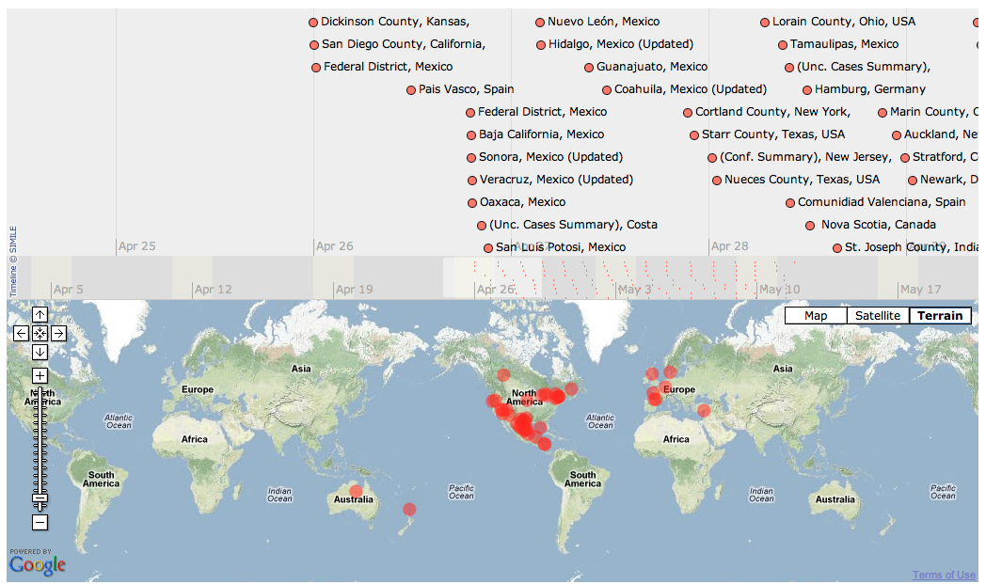
Timemaps

Slide 71
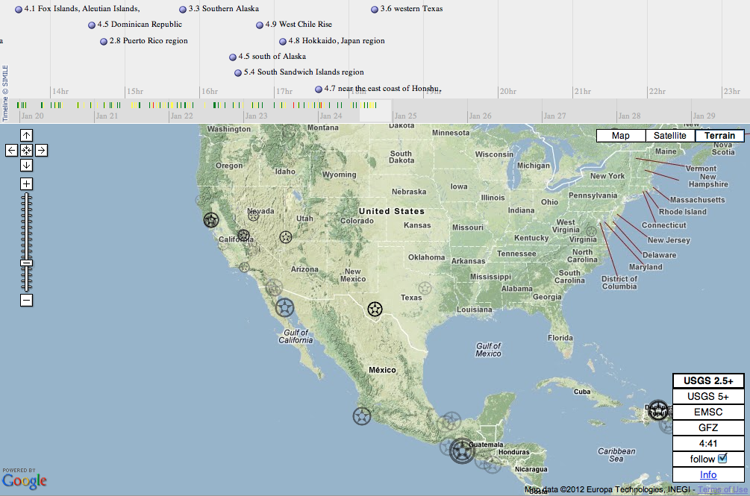
Notes:
http://www.oe-files.de/gmaps/eqmashup.html

Slide 72
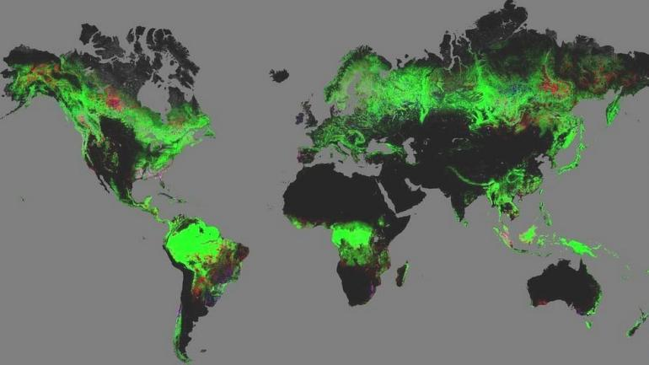
Global Forest Change (showing changes)

Slide 73
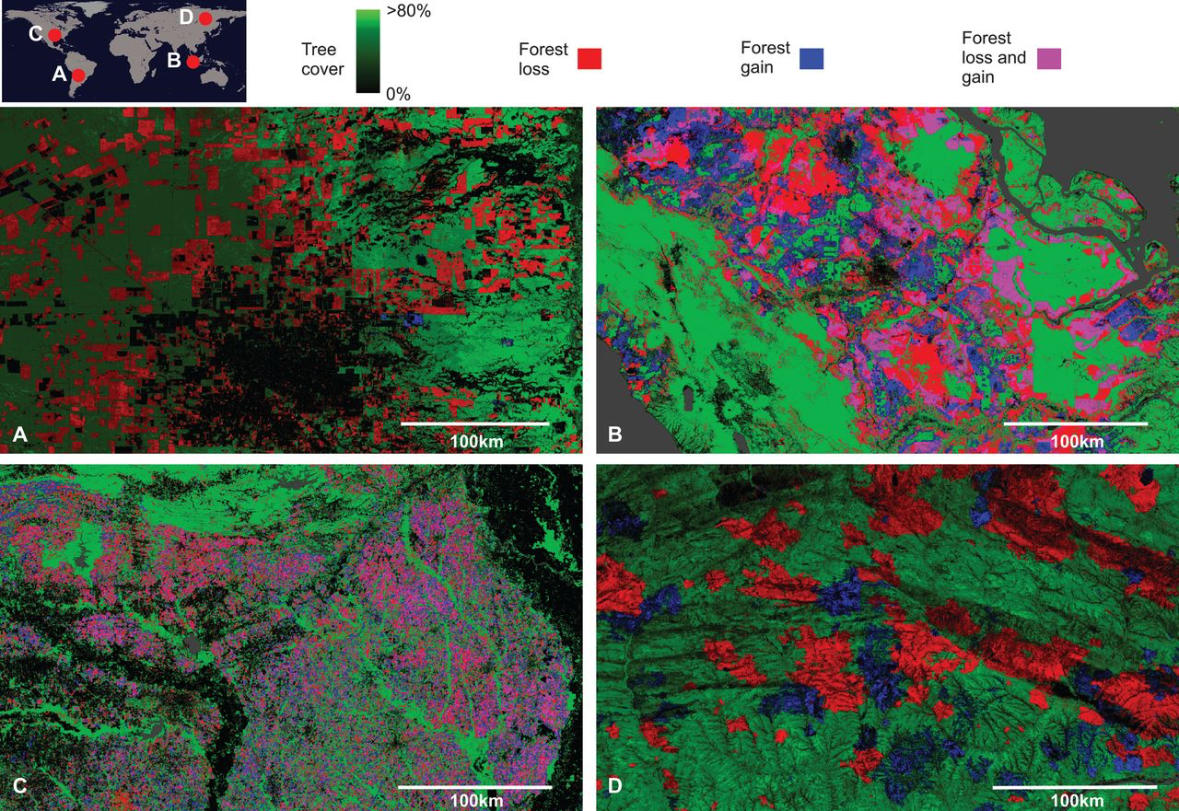

Slide 74
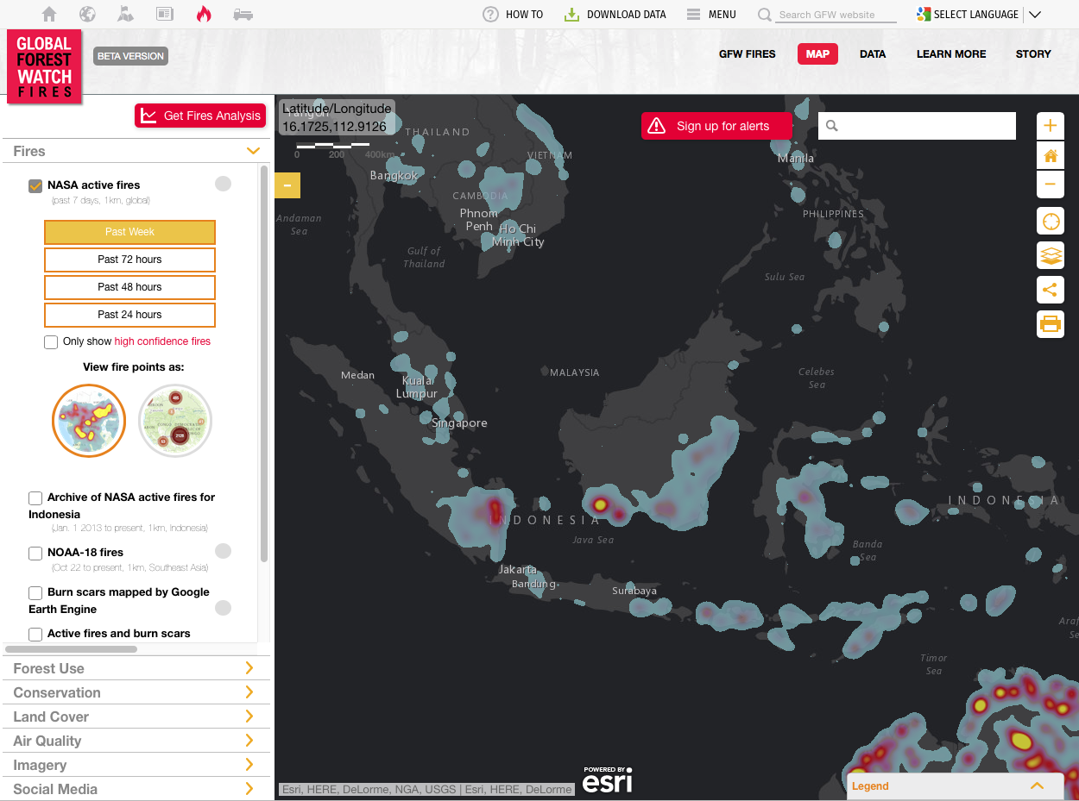

Slide 75
How to draw on maps

Slide 76
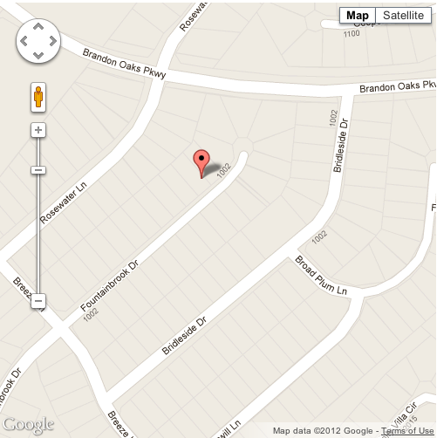
Plotting things on maps: points

Slide 77

Plotting things on maps: polygons

Slide 78

Plotting things on maps: points and lines

Slide 79


Slide 80


@DavKidd

Slide 81
Geophylogenies

Slide 82


Slide 83


Slide 84



Slide 86

http://iphylo.org/~rpage/geojson-phylogeny-demo/

Slide 87
Beyond dots and lines on maps

Slide 88

Beyond points
Discrete digital grids divide the planet up into cells of equal area.

Slide 89

Great Globe Project (proposed) 128m diameter, 10.5 million tiles

Slide 90

Great Globe (model on display in Paris)

Slide 91


Slide 92
The End
Maps are a classic tool for visualizing data
We can add all kinds of information to maps using tools such as Google Earth and formats such as KML and GeoJSON
Geographic data is typically unevenly sampled
The use of two numbers (latitude and longitude) that can be either positive (E, N) or negative (W, S) is very powerful, and easy to get wrong

